Slide 1
Chapter 5
Exploratory Data Analysis

Slide 2
Learning Objectives
Describe the meaning and purpose of explore statistics
Explain the major statistical measures in the explore procedure such as confidence interval of mean, interquartile range, trimmed mean, skewness, kurtosis, outliers and percentiles
Estimate the unknown population parameter based on point estimate and confidence interval methods
Demonstrate the steps used in SPSS for data distribution with single- and multiple-box plots

Slide 3
Explain the steps used in SPSS to generate category-wise box plots for an independent variable
Demonstrate the steps used in SPSS to examine normality in a data set through graphics (Q–Q and P–P plots) and test statistics
Explain how to select a variable along with a relevant scale for computing graphs and statistics in the explore procedure

Slide 4
Exploring Statistics with SPSS
The explore procedure describes data either in summary statistics or graphics. The visual methods convey the information of the data set in a compact and effective way to detect the relationship among the variables, comparing, examining and verifying the relevant assumptions to apply statistical techniques.
Exhibit 5.1. Use retail.sav » Menu bar » analyse » Descriptive statistics » Explore » Select Distance » Transfer to the right-handed box labelled as Dependent List » Select Gender » Transfer to the right-handed box labelled as Factor List » Statistics » Descriptive » Click OK

Slide 5
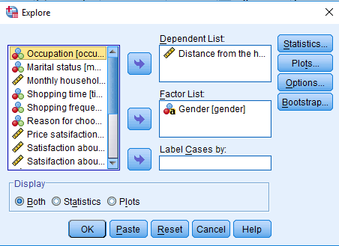
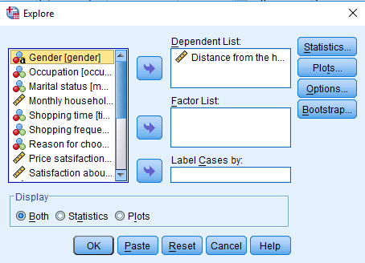

Slide 6
Table 5.1. Explore Statistics
Variable: Distance
Statistics |  | Male | Female | Statistics | Male | Female
Mean |  | 6 | 5.5 | Range | 9 | 10
95% CI for mean | L.B. | 5.44 | 4.83 | Interquartile range | 3 | 3
 | U.B. | 6.55 | 6.18 | Skewness | 0.425 | 0.347
5% trimmed mean |  | 5.95 | 5.45 | Kurtosis | -0.851 | 0.011
Median |  | 5 | 5 | Standard error of mean | 0.277 | 0.335
Variance |  | 5.78 | 5.07 | Standard error of skewness | 0.277 | 0.354
Standard deviation |  | 2.40 | 2.25 | Standard error of kurtosis | 0.548 | 0.695
Notes: LB: Lower Bound; UB: Upper Bound.

Slide 7
Explore Statistics for Sample Data
Exhibit 5.2. Use retail.sav » Menu Bar » analyse » Descriptive statistics » Explore » Select Distance » Transfer to Right-handed box labelled as Dependent List » Click OK

Slide 8
Table 5.2. Explore Statistics: Distance
Variable: Distance
Statistics |  |  | Statistics
Mean |  | 5.8 | Range | 10
95% CI for mean | LB | 5.3 | Interquartile range | 3
 | UB | 6.2 | Skewness | 0.4
5% trimmed mean |  | 5.7 | Kurtosis | −0.5
Median |  | 5.0 | Standard error of mean | 0.21
Variance |  | 5.5 | Standard error of skewness | 0.22
Standard deviation |  | 2.3 | Standard error of kurtosis | 0.43
Notes: LB: Lower Bound; UB: Upper Bound.

Slide 9
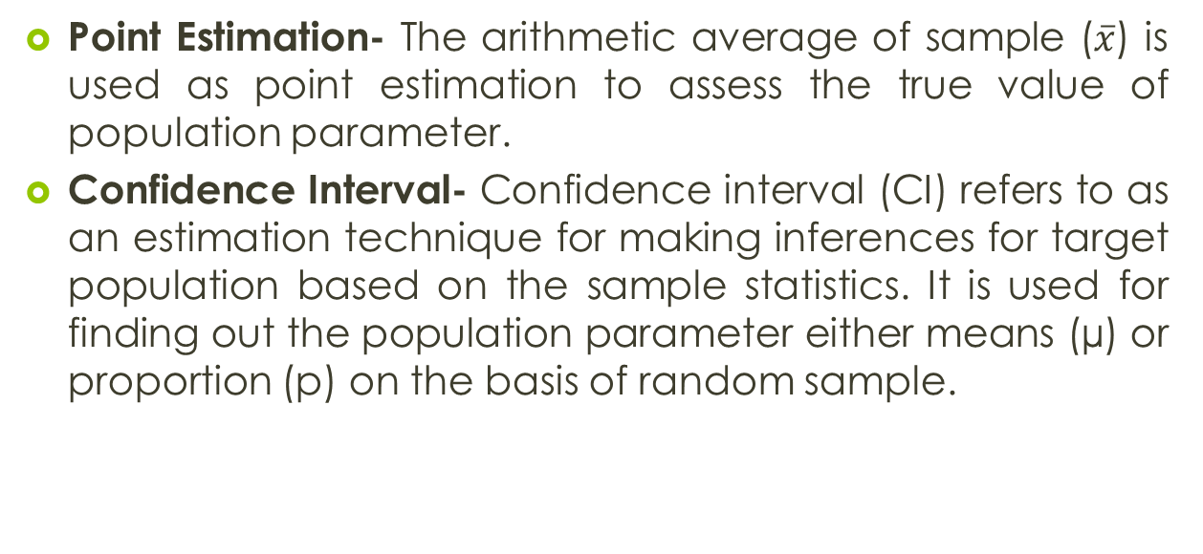
Estimating Population Parameter

Slide 10
Table 5.3. Confidence Interval and Levels of Significance
Z Values for Commonly Used Confidence Levels
90% | Sample mean ± 1.645* x SE of mean
95% | Sample mean ± 1.96 x SE of mean
99% | Sample mean ± 2.576 x SE of mean
Table 5.4. Confidence Interval for Distance
Confidence Interval | Lower Bound | Upper Bound
Male | 6.0 −1.96x 0.277 = 5.44 | 6.0 + 1.96 x 0.277 = 6.55
Female | 5.5 −1.96 x 0.335 = 4.83 | 5.5 +1.96 x 0.277 = 6.18

Slide 11
Factors Affecting Confidence Interval Estimates
Standards Error of Mean (SEM): The width of CI is affected with the amount of standard error in the sample. Higher the standard error, higher will the range of the CI.
Table 5.5. Effect of Standard Error of Mean
Variable: Variety | Male | Female
Mean | 4.45 | 4.40
Standard error of mean | 0.25 | 0.32
Range of 95% CI | 3.94 − 4.90 = 1.02 | 3.74 − 5.05 = 1.31

Slide 12
Level of Confidence: Any change that occurs in the level of confidence results into a change in the range of CI. If we increase the level of significance (from 5% to 10%), the CI range would decrease.
Table 5.6. Effect of Confidence Intervals
Variable: Variety | Range of Confidence Interval
LOS | Male | Female
1% | 3.77 − 5.13 = 1.36 | 3.52 − 5.27 = 1.75
5% | 3.94 − 4.90 = 1.02 | 3.74 − 5.05 = 1.31
10% | 4.02 − 4.88 = 0.86 | 3.85 − 4.94 = 1.09

Slide 13
Sample Size: The precision of confidence interval also depends on the sample size. A large sample results in smaller standard deviation and standard error, hence the confidence interval becomes narrower and precise.
Trimmed Mean: The pre-specified percentages of the extreme values (smallest and largest) are removed from the data before calculating the average. The values obtain from trimmed mean is unaffected from outliers in case of extremely skewed distribution data set.

Slide 14
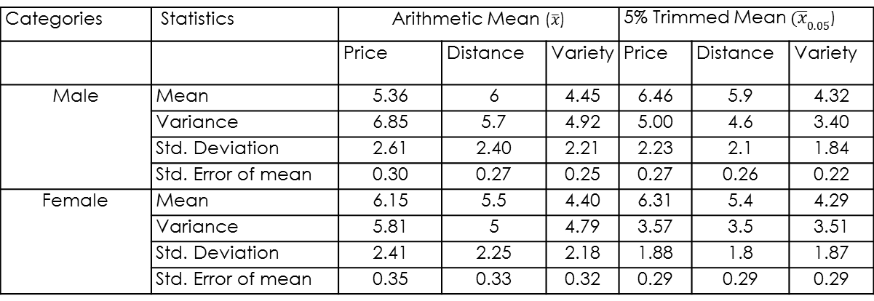
Table 5.7. Effect of Trimmed Mean
Categories | Statistics
 |  | Price | Distance | Variety | Price | Distance | Variety
Male | Mean | 5.36 | 6 | 4.45 | 6.46 | 5.9 | 4.32
 | Variance | 6.85 | 5.7 | 4.92 | 5.00 | 4.6 | 3.40
 | Standard deviation | 2.61 | 2.40 | 2.21 | 2.23 | 2.1 | 1.84
 | Standard error of mean | 0.30 | 0.27 | 0.25 | 0.27 | 0.26 | 0.22
Female | Mean | 6.15 | 5.5 | 4.40 | 6.31 | 5.4 | 4.29
 | Variance | 5.81 | 5 | 4.79 | 3.57 | 3.5 | 3.51
 | Standard deviation | 2.41 | 2.25 | 2.18 | 1.88 | 1.8 | 1.87
 | Standard error of mean | 0.35 | 0.33 | 0.32 | 0.29 | 0.29 | 0.29

Slide 15
Outliers
Another important part of explore statistic is detecting the outliers from the data set in order to enhance the validity of the results.
Exhibit 5.3. Use retail.sav » Menu bar » analyse » Descriptive statistics » Explore » Select Gender and transfer to Factor List box » Select Distance and transfer to Dependent List » Select Statistics under Display box » Statistics (select) Outliers » Continue » Click OK

Slide 16
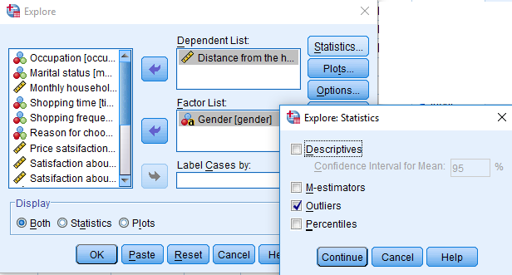

Slide 17
Table 5.8. Outliers in Data Set
Variable: Distance |  | Five-Highest |  | Five-Smallest
 |  | Male | Female | Male | Female
1 | Outliers with specific case number | 31 (11) | 35 (11) | 101 (2) | 67 (1)
2 |  | 13 (10) | 6 (10) | 43 (2) | 102 (2)
3 |  | 26 (10) | 64 (10) | 105 (3) | 91 (2)
4 |  | 30 (10) | 79 (9) | 78 (3) | 47 (2)
5 |  | 34 (10) | 9 (8) | 55 (3) | 18 (2)

Slide 18
Category-wise Percentiles Values
In the explore statistics, the percentiles can be computed for the various categories of independent variable(s) for more in-depth analysis.
Exhibit 5.4. Use retail.sav » Menu bar » analyse » Descriptive statistics » Explore » Select Marital and transfer to Factor List box » Select Distance and transfer to Dependent List » Select Statistics under Display box » Statistics (select) Percentiles » Continue » Click OK

Slide 19
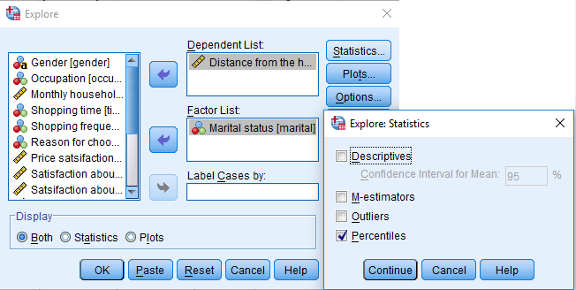
Compute Percentile for Various Categories
Table 5.9. Percentiles Values
Percentiles |  | 5th | 10th | 25th | 50th | 75th | 90th | 95th
Variable: Distance | Married | 2.0 | 3.0 | 4.0 | 6.0 | 8.0 | 10.0 | 10.0
 | Single | 2.0 | 3.0 | 3.5 | 5.0 | 6.5 | 9.4 | 10.0

Slide 20
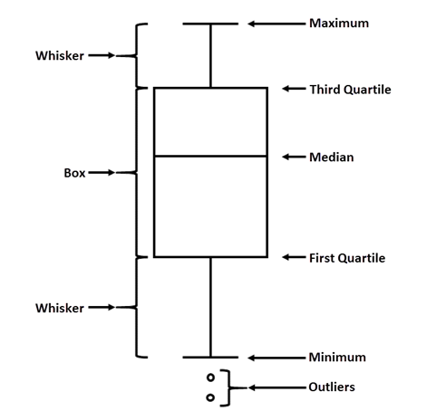
Exploring Data with Plots
Exploring Data with Box Plot: A box plot is used to display the overall pattern of data distribution graphically. It provides a useful way to visualize various characteristics of a particular data set, such as shape of data distribution, skewness, kurtosis and presence of outliers.
Rectangular box: The rectangular box represents 50% of the observed values in a data set.
Hinges: Both the edges of a rectangular box are called hinges.
Whiskers: The whiskers refers to the range of values from lower quartile hinge to smallest value in the data.
Outliers: Extreme values either at lower or upper side of the data distribution can be easily identified by the appearance of bullets along with the case label.
Outlier: Q1 − 1.5 IQR; Q3 + 1.5 IQR

Slide 21
Preparing Single Box Plot
A dependent variable is to be measured at either interval or ratio scale, whereas an independent variable is based on the nominal scale.
Exhibit 5.5. Use retail.sav » Menu bar » analyse » Descriptive statistics » Explore » Select Promotion and transfer to Dependent List box » Select Plots under Display box » Plots » (select) Factor levels together in Boxplot area » Continue » Click OK

Slide 22
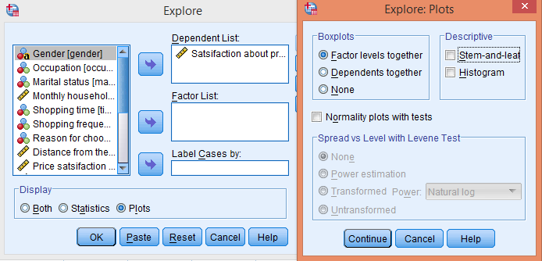
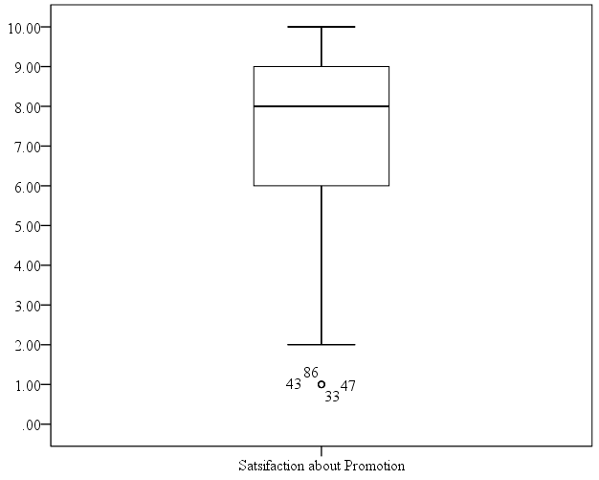

Slide 23
Preparing Multiple Box Plots
The software also displays multiple box plots for various dependent variables. In this layout, the various box plots are compared to each other by using five-number summary that includes median, 25th percentile, 75th percentile, minimum and maximum values.
Exhibit 5.6. Use retail.sav » Menu bar » analyse » Descriptive statistics » Explore » Select Distance, Price, Promotion, and Staff service » Transfer to Dependent List box » Select Plots under Display box » Click Plots » Select Dependents together » Continue » Click OK

Slide 24
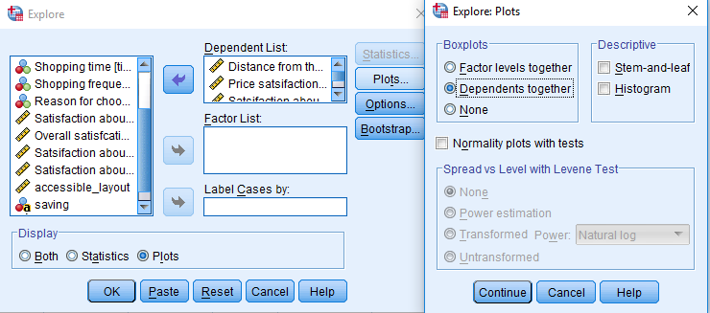
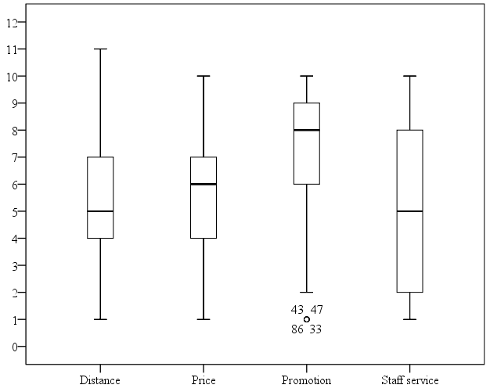

Slide 25
Category-wise Multiple Box Plots
The variation in data distribution of a particular dependent variable corresponding to the respective categories of the independent variable can also be examined by multiple box plots.
Exhibit 5.7. Use retail.sav » Menu bar » analyse » Descriptive statistics » Explore » Select Distance and transfer to Dependent List box » Select Occupation and transfer to Factor List » Select Plots under Display box » Plots » Select Factor levels together in Boxplots area » Continue » Click OK

Slide 26
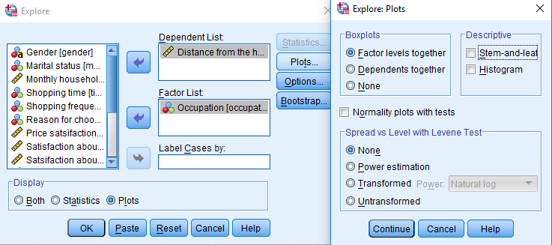
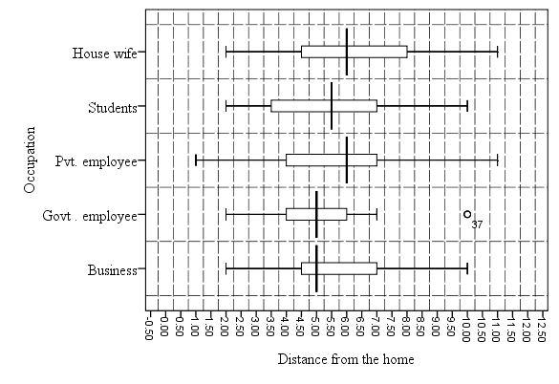

Slide 27
Exploring Data with Stem-and-Leaf Plot: Single Variable
Similar to histogram, this method is also used to display the frequency of certain values in the form of frequency distribution table.
Exhibit 5.8. Use retail.sav » Menu bar » analyse » Descriptive statistics » Explore » Select Distance and transfer to Dependent List box » Select Plots under Display box » Plots (select) Stem-and-leaf » Continue » Click OK

Slide 28
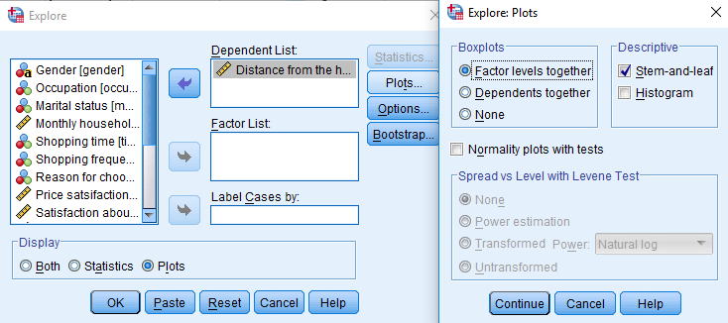
Stem-and-Leaf Plot Frequency Stem & Leaf 1.00 1. 0 6.00 2. 000000 11.00 3. 00000000000 20.00 4. 00000000000000000000 25.00 5. 0000000000000000000000000 14.00 6. 00000000000000 16.00 7. 0000000000000000 9.00 8. 000000000 3.00 9. 000 13.00 10. 0000000000000 2.00 11. 00 Stem width: 1.00 Each leaf: 1 case (s)

Slide 29
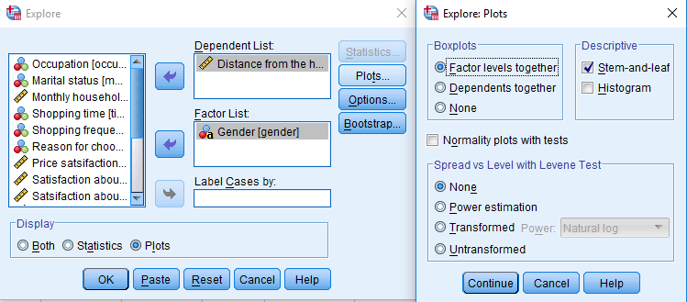
Stem-and-Leaf Plot: Category Wise
The variation occurs in data distribution of a particular dependent variable corresponding to the respective categories of the independent variable and can also be examined by stem-and-leaf plot.

Slide 30
In this way, several stem-and-leaf plots belonging to each category of an independent variable appear in a single chart. The number of plots will be equal to the number of categories of the independent variable.
Stem-and-Leaf Plot for distance
Gender: Male Frequency Stem & Leaf 2.00 2 . 00 10.00 3 . 0000000000 11.00 4 . 00000000000 15.00 5 . 000000000000000 7.00 6 . 0000000 12.00 7 . 000000000000 4.00 8 . 0000 2.00 9 . 00 11.00 10 . 00000000000 1.00 11 . 0 Stem width: 1.00 Each leaf: 1 case(s) | Gender: Female Frequency Stem & Leaf 1.00 1 . 0 4.00 2 . 0000 1.00 3 . 0 9.00 4 . 000000000 10.00 5 . 0000000000 7.00 6 . 0000000 4.00 7 . 0000 5.00 8 . 00000 1.00 9 . 0 2.00 10 . 00 1.00 11 . 0 Stem width: 1.00 Each leaf: 1 case(s)

Slide 31
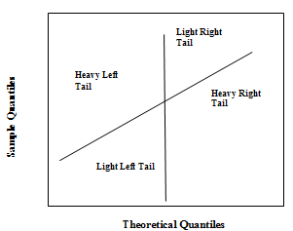
Normal Probability Plot
The normal probability plots (P–P: Probability–probability; Q–Q: quantile–quantile) illustrate graphical fit to normality and indicate whether a sample selected is from a normally distributed population or not. These plots are used to compare observed values of a data set with the expected values from a normal distribution.
P–P Plot: Compares empirical cumulative distribution function of observed variable with a standard normal distribution function.
Q–Q Plot: Compares observed values of a variable to the quantiles of normal distribution.
In case the underlying data is normally distributed, the points fall within a narrow band along the straight line. Similarly, deviation from this line indicates non-normality of the data set.
The appearance of curvature at both ends of the curve indicates short or long distribution tails, whereas convex and concave curvature indicate skewness in a data set.

Slide 32
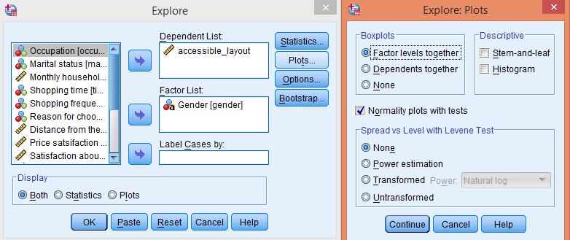
Prepare Normal Probability Plots
Exhibit 5.9. Use retail.sav » Menu bar » analyse » Descriptive statistics » Explore » Select accessible_layout and transfer to Dependent List box » Select Gender and transfer to Factor List » Select both the options under Display box » Plots (select) Normal plots with tests » Continue » Click OK

Slide 33
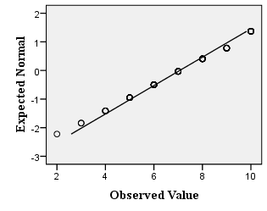
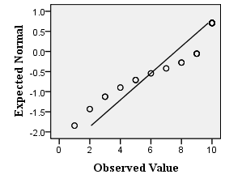
Figure 5.1. Q–Q Plot for Female Category
Figure 5.2. Q–Q Plot for Male Category

Slide 34
Table 5.10. Test for Normality
Variable | Gender | Kolmogorov–Smirnov
 |  | Statistic | df | Sig.
accessible layout | Male | 0.134 | 75 | 0.002
 | Female | 0.120 | 45 | 0.103
The p-value associated with Kolmogorov–Smirnov test statistic is less than 0.05 (p < 0.05, 0.002) at 5% level of significance (LoS) for male category. This lower p-value indicates that the data distribution is significantly different from the normality.
Whereas, the high p-value for female category (p > 0.05, 0.103) indicates a normal distribution data for accessible layout.

Slide 35
Scale Requirements for Exploratory Data Analysis
Task | Scope of Analysis | Variables Required | Required Scale
Descriptive statistics, detection of outliers and percentile | All sample data | One or more | Dependent variable: Interval or ratio
 | Category wise | At least one independent and one dependent variable | Independent variable: Nominal (at least two categories) and Dependent variable: Interval and ratio
Explore plots | Single box plot for each variable | One dependent variable | Interval or ratio
 | Several box plots in single chart | More than one dependent variable | Interval or ratio
 | Several box plots category wise | One dependent variable and one independent variable | Independent: Nominal (at least two categories) and Dependent variable: Interval and ratio
Stem-and-leaf plot and normal probability (Q–Q plot) | Single plot for each variable | One dependent variable | Interval or ratio
 | Several plots category wise | One dependent variable and one independent variable | Independent: Nominal Dependent: Interval and ratio

Slide 36
Key Terms
Box plot Confidence interval Normal probability plot (P-P and Q-Q) Outliers Point estimation | Population parameter Stem and Leaf plot Test statistics Trimmed mean Z -score

